Slide 1
Create a backend Fibonacci Microservice
and deploying it on IBM Bluemix Cloudfoundry
Arpit Jain

Slide 2
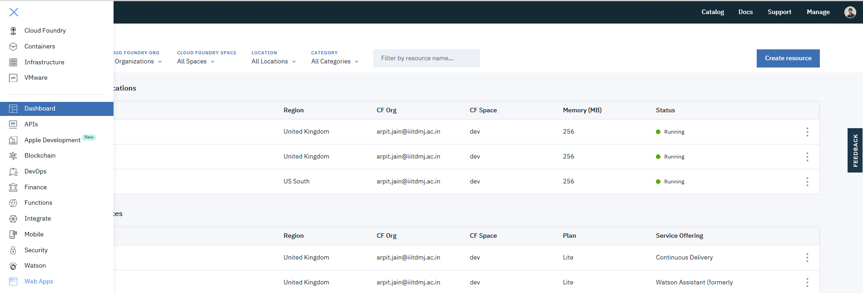
Step 1 : When you are on the IBM Cloud Dashboard, Go to the
Web Apps section from the Hamburger Menu

Slide 3
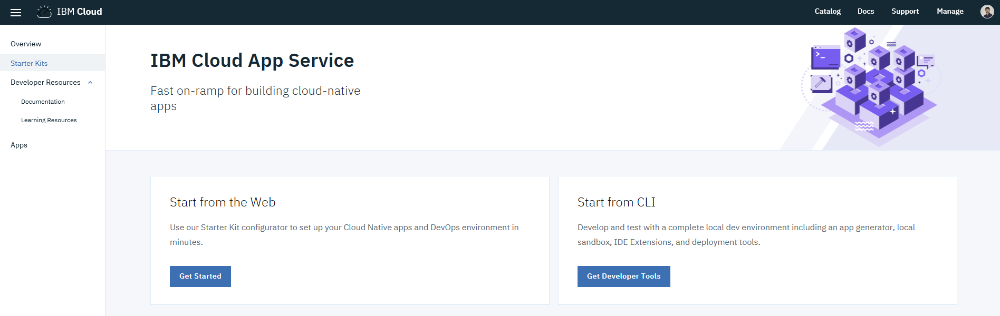
Step 2 : Select the Starter Kit for the application template.

Slide 4
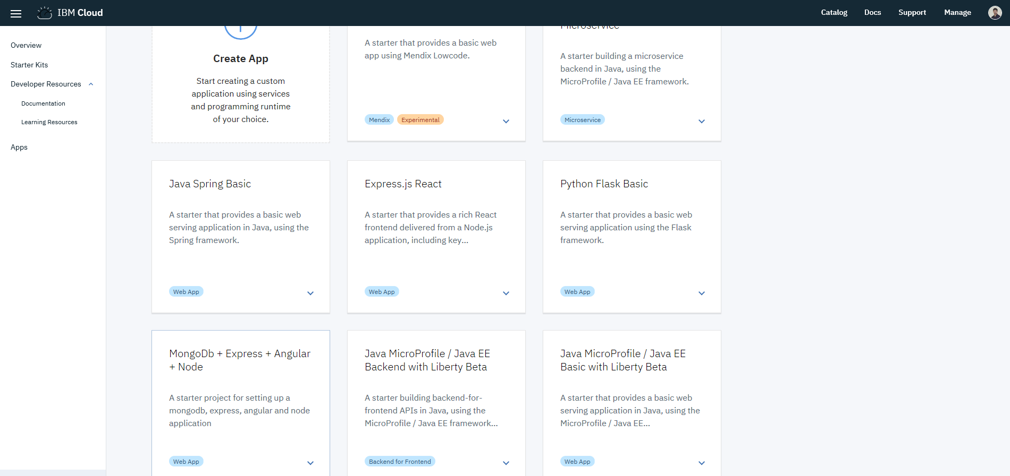
Step 3 : Select Node.js template

Slide 5
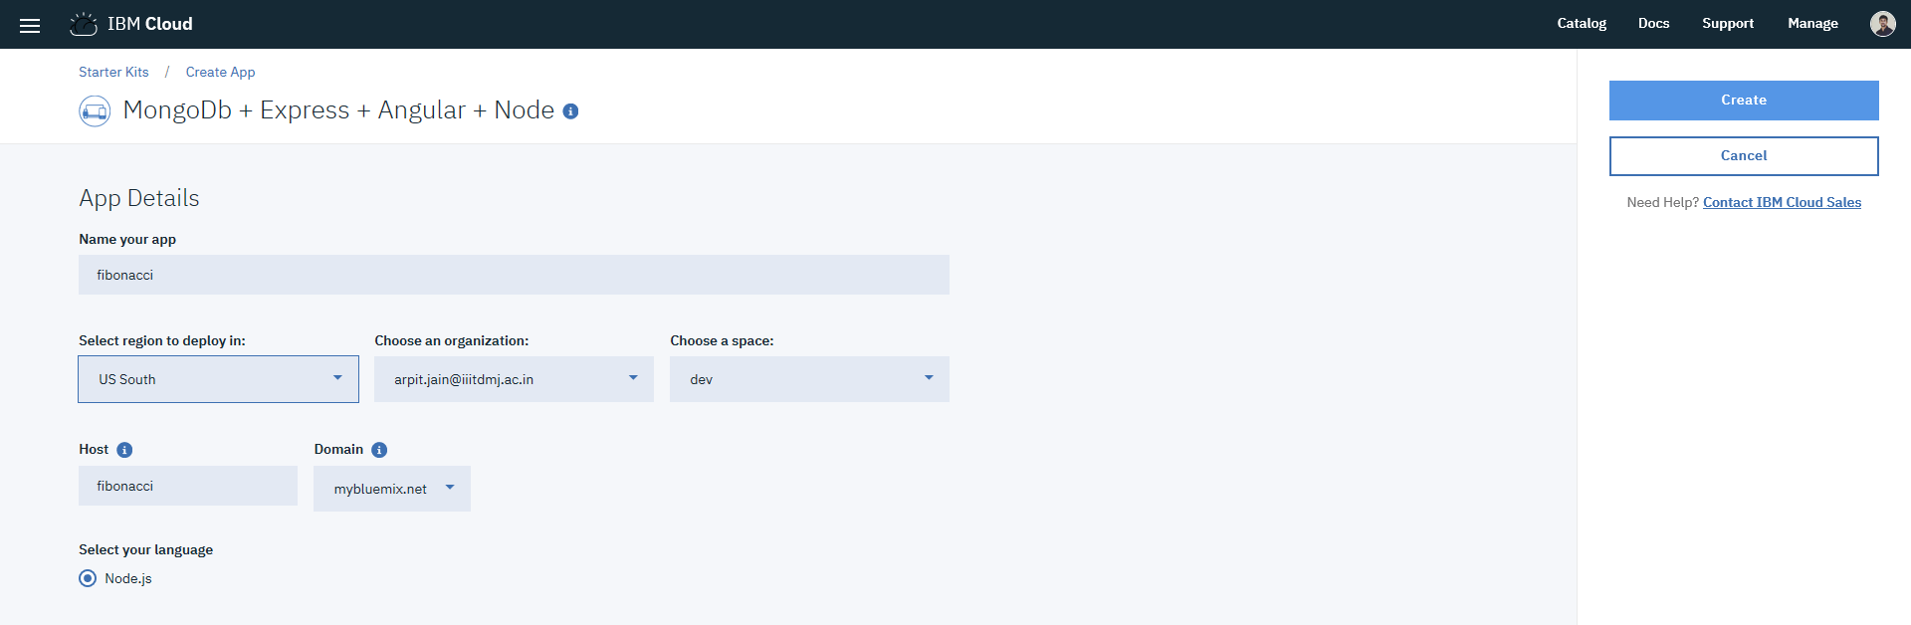
Step 4 : Specify the application attributes

Slide 6
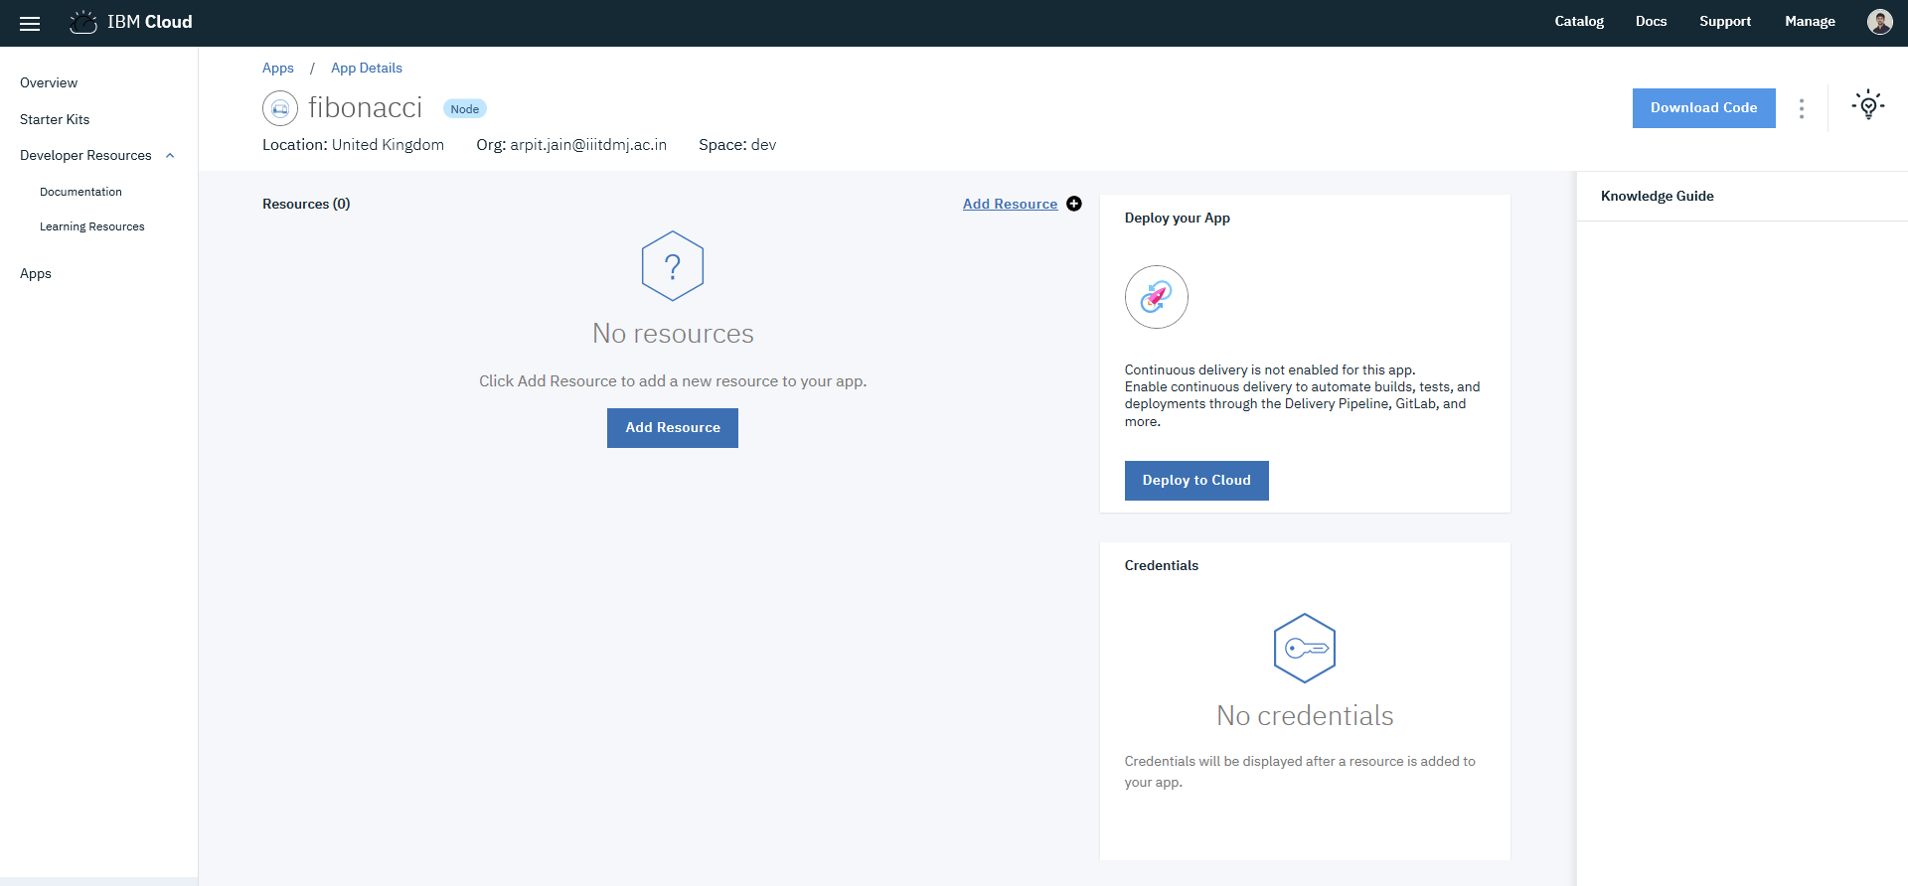
Step 5 : The App space is created on the cloud. (Application is not yet running)

Slide 7
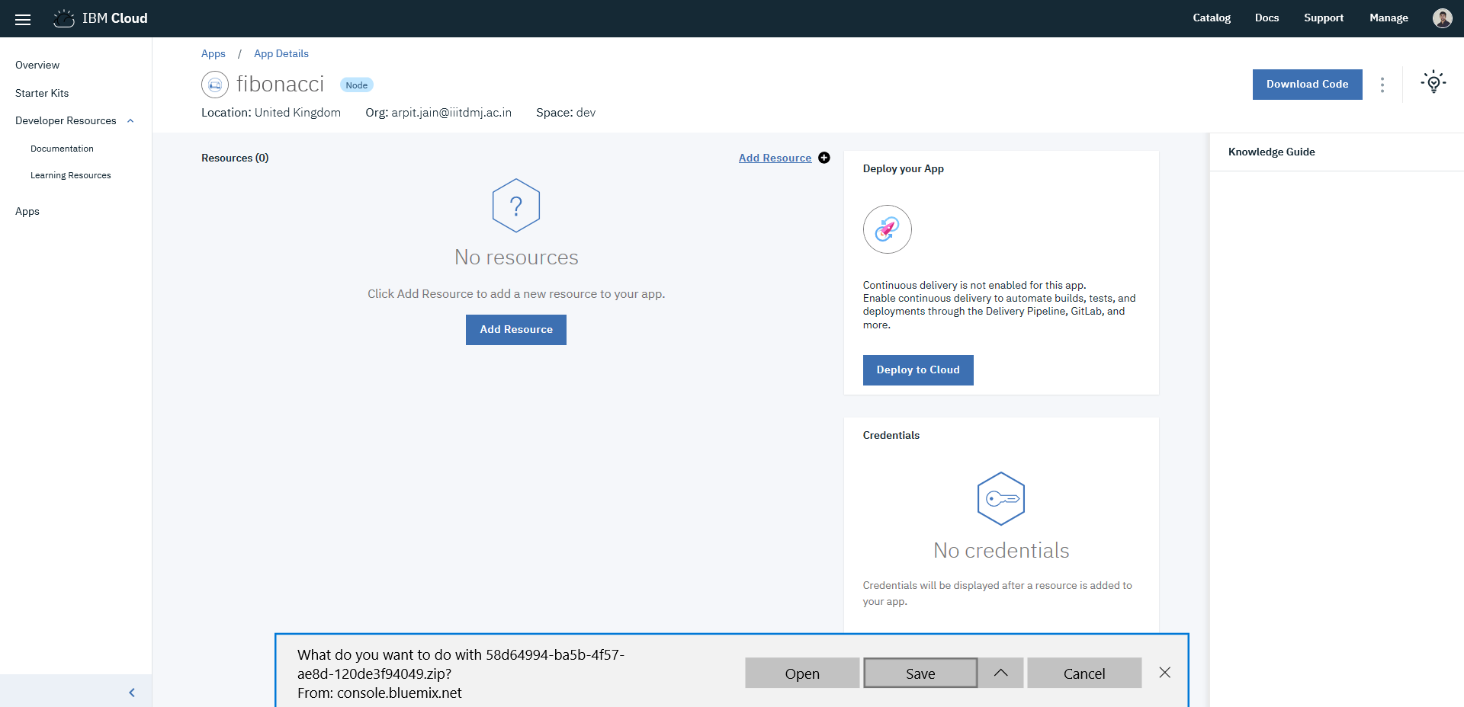
Step 6 : Download starter code

Slide 8
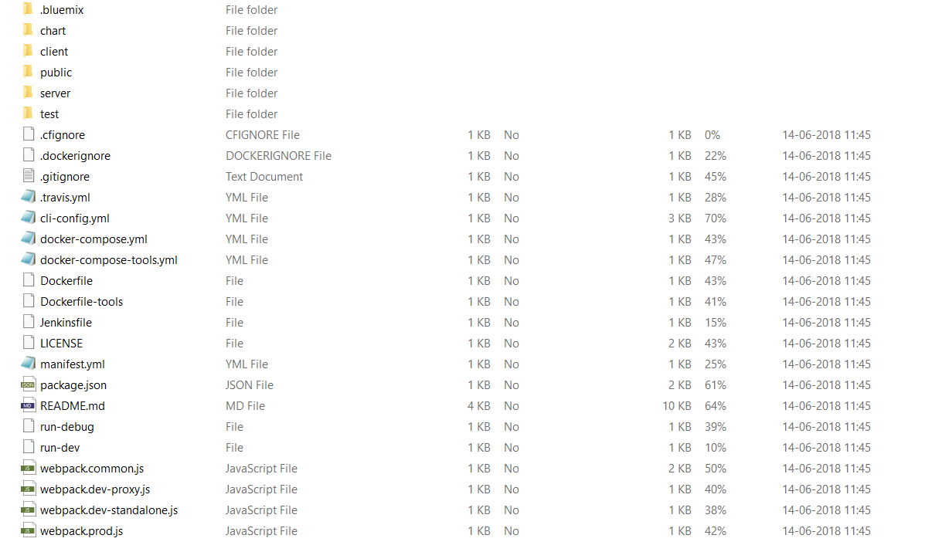
Step 7 : Open the code in explorer and build upon it.
Code the Fibonacci Microservice using this starter template.

Slide 9
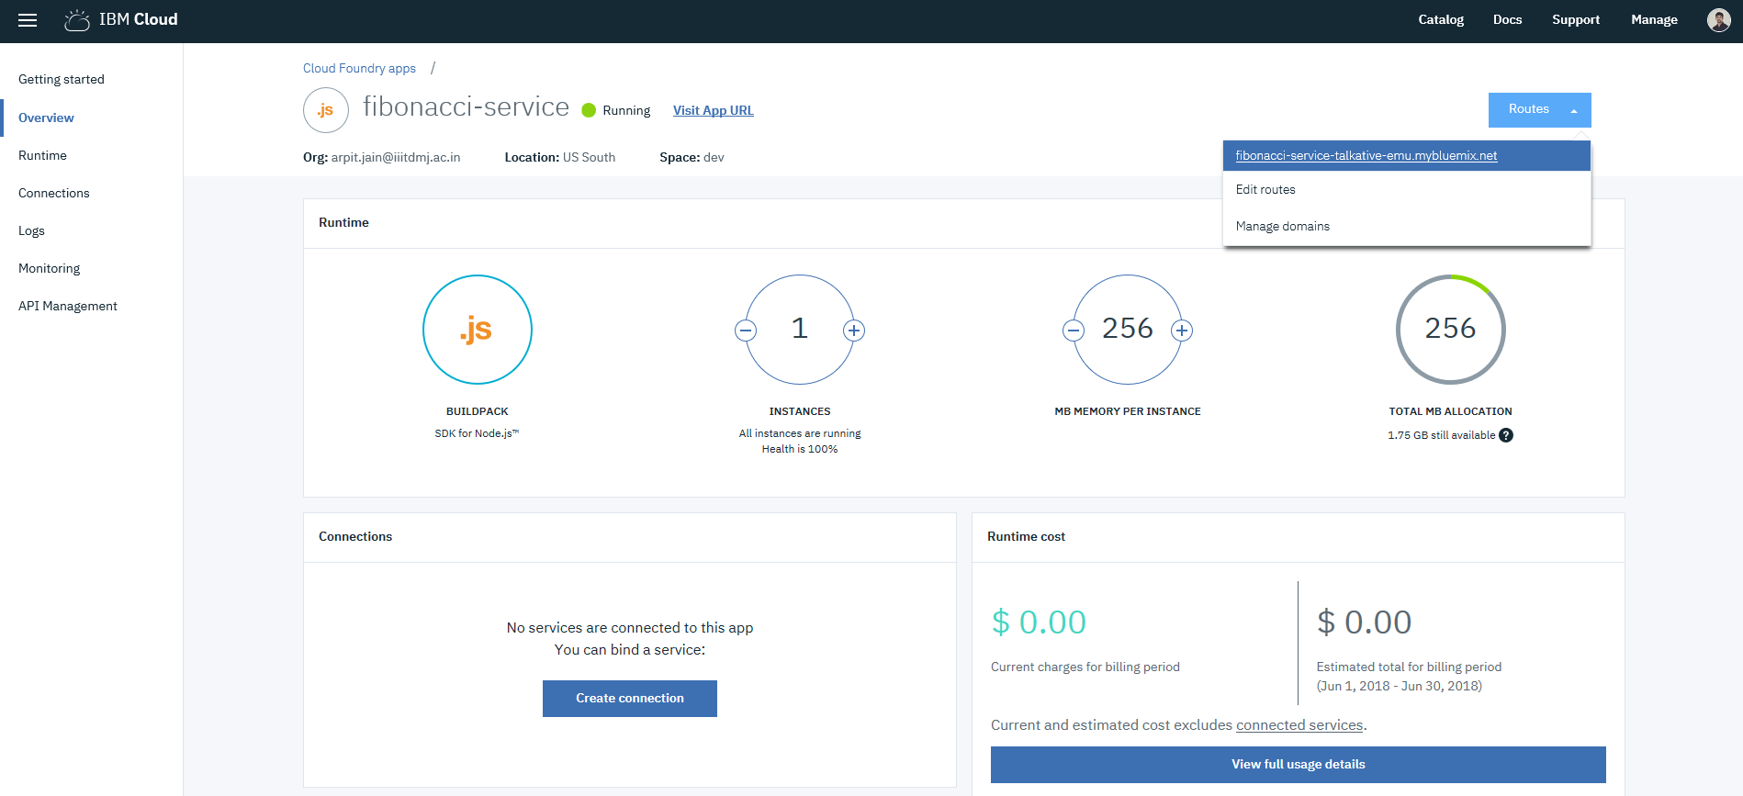
Step 8 : Open the application route to check if Microservice is up and running.

Slide 10
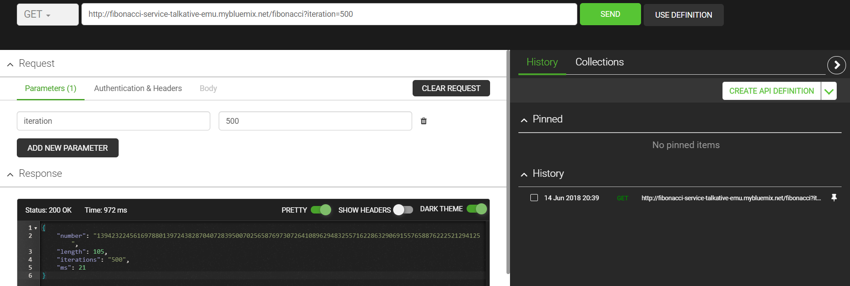
Step 9 : Making call requests to the microservice.

Slide 11
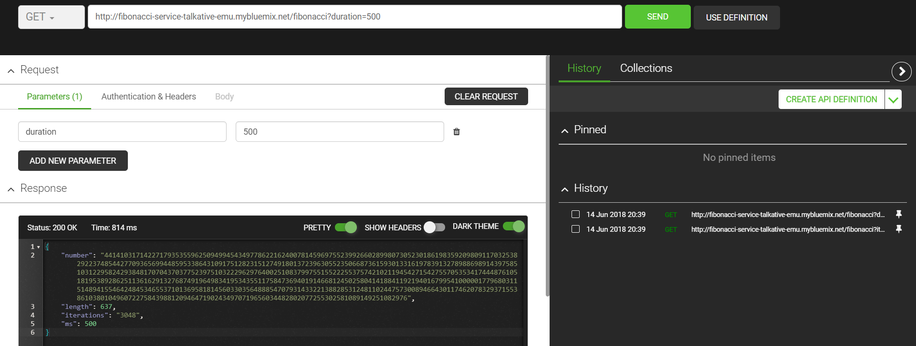
Step 10 : Making call requests to the microservice.

